Slide 1
Course Success Prediction System
Using Exploratory Data Analysis & Machine Learning
Submitted by: Jibina MV
Domain: Data Science / Machine Learning
Tool: Python, Jupyter Notebook, Streamlit/Flask

Slide 2
Project Objective
To analyze course-related data using Exploratory Data Analysis (EDA)
To build a machine learning model that predicts a Course Success Score
To deploy the trained model as a web application
To provide AI-based feedback based on prediction results

Slide 3
Dataset Overview
The dataset contains information related to online courses:
Features Used:
Number of Learners
Course Rating (0–5)
Course Duration (Hours)
Difficulty Level (1–5)
Target Variable:
Course Success Score

Slide 4
Data Preprocessing
Converted columns to numeric format
Handled missing values using:
Mean for continuous values
Median where required
Removed or treated outliers
Ensured clean and structured dataset before modeling

Slide 5
Exploratory Data Analysis (EDA)
EDA was performed to understand patterns and relationships in data:
Statistical summary (mean, median, std)
Distribution analysis using histograms
Correlation analysis between features
Identification of important features affecting success score

Slide 6
Key EDA Insights
Courses with higher ratings tend to have higher success scores
A large number of learners indicates higher popularity and success
Moderate course duration performs better than extremely long courses
Very high difficulty levels may reduce course success

Slide 7
Feature Importance
Based on EDA and model behaviour
Rating is the most influential feature
Learners count strongly impacts prediction
Duration and difficulty have moderate influence

Slide 8
Model Building
Dataset split into training and testing sets
Features scaled using StandardScaler
Regression-based machine learning models applied
Model performance evaluated using:
R² Score
RMSE (Root Mean Square Error)

Slide 9
Best Model Selection
Multiple models were trained and compared
The best-performing model was selected based on accuracy
Final model saved using pickle for deployment

Slide 10
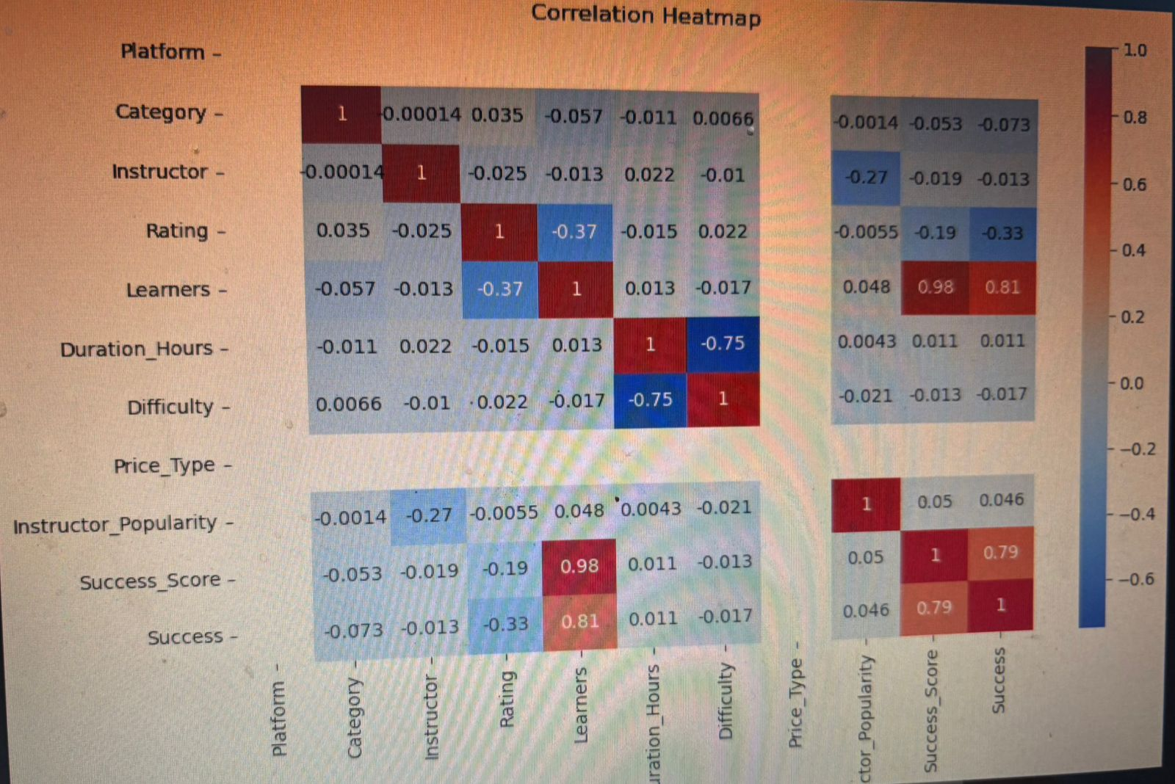
CORRELATION VIEW

Slide 11

PREDICTION PAGE WEB VIEW

Slide 12
